Slide 1
Life cycle assessment of single-use and reusable surgical instruments
Kristian Hemström
SLL Environment
Stockholm County Council

Slide 2
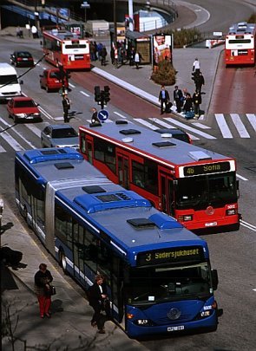
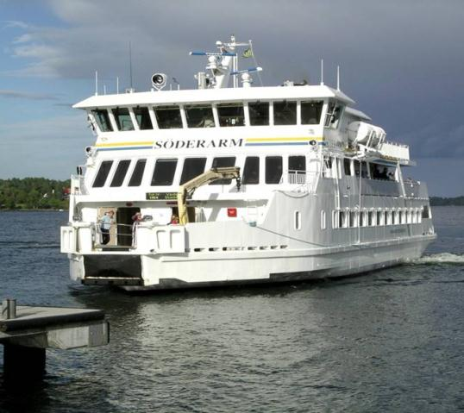
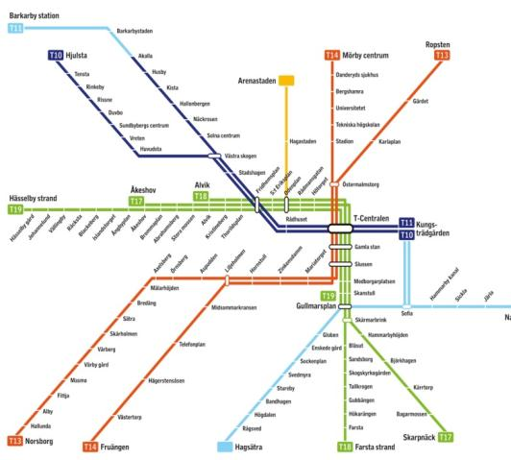
44,000 employees
Agreements with 1,000 private care providers and transport companies
every day:
  40,000 healthcare visits
  780,000 passengers in public transportation
Stockholm County Council

Slide 3

Political environmental program
The County Council shall perform its undertaking in a way that is climate-efficient and resource-efficient, and shall carry out health-promoting environmental work.

Slide 4
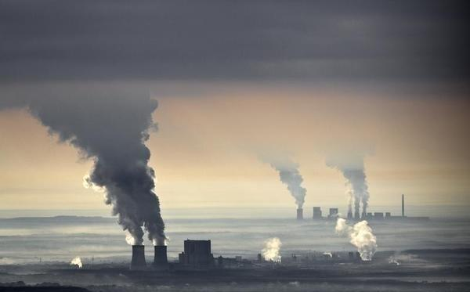
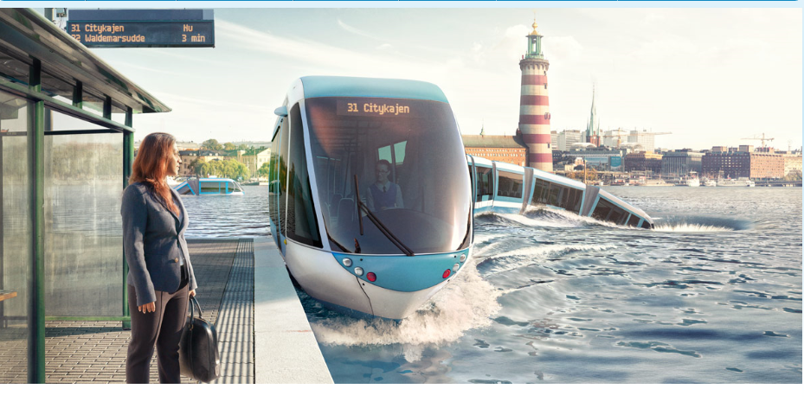
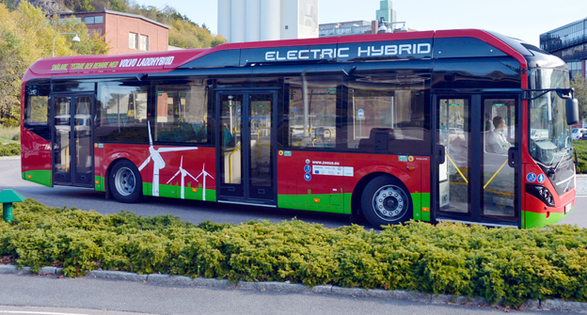
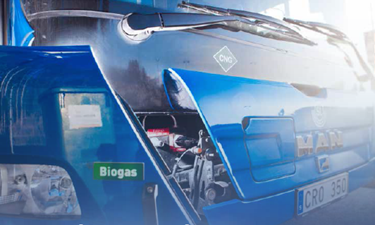
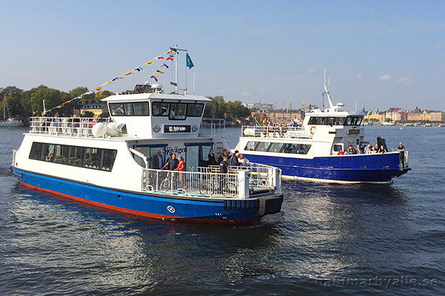


Climate
Subway and commuter trains
100 % renewable sources
87 % renewable fuels in busses
75 % renewable fuels in all transports
Battery-powered ship
Winner
Graphic from The Swedish Association of Graduate Engineers

Slide 5
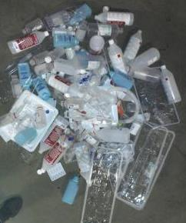
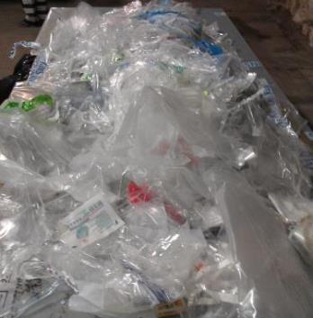
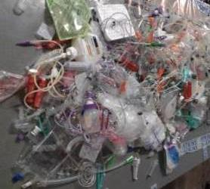
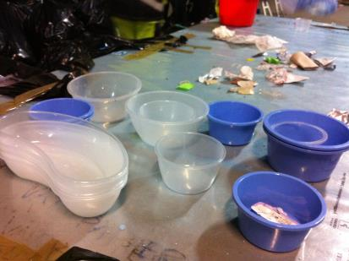
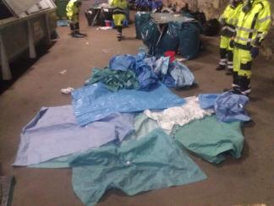
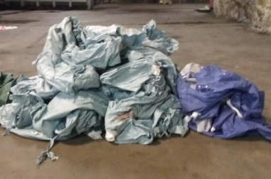
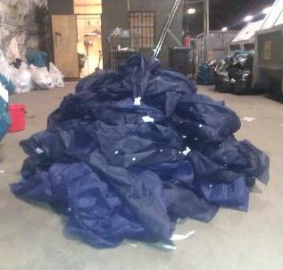
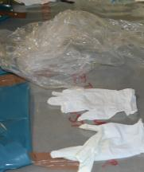
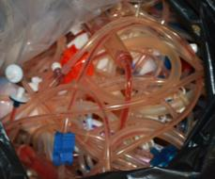
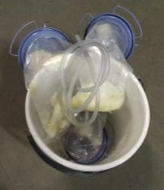
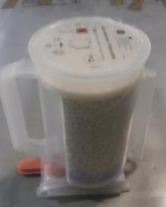
Product | Consumtion | Carbon footprint
Gloves | 100 000 000 | 2 500 tons CO2-eq
Protective aprons | 12 000 000 | 1 750 tons CO2-eq
Trash bags | >>4 000 000 | >>800 tons CO2-eq
….
….

Slide 6
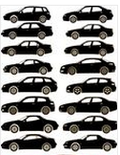
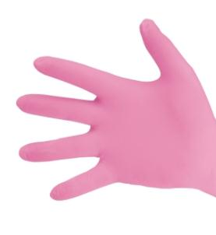
100 million/yr

Slide 7
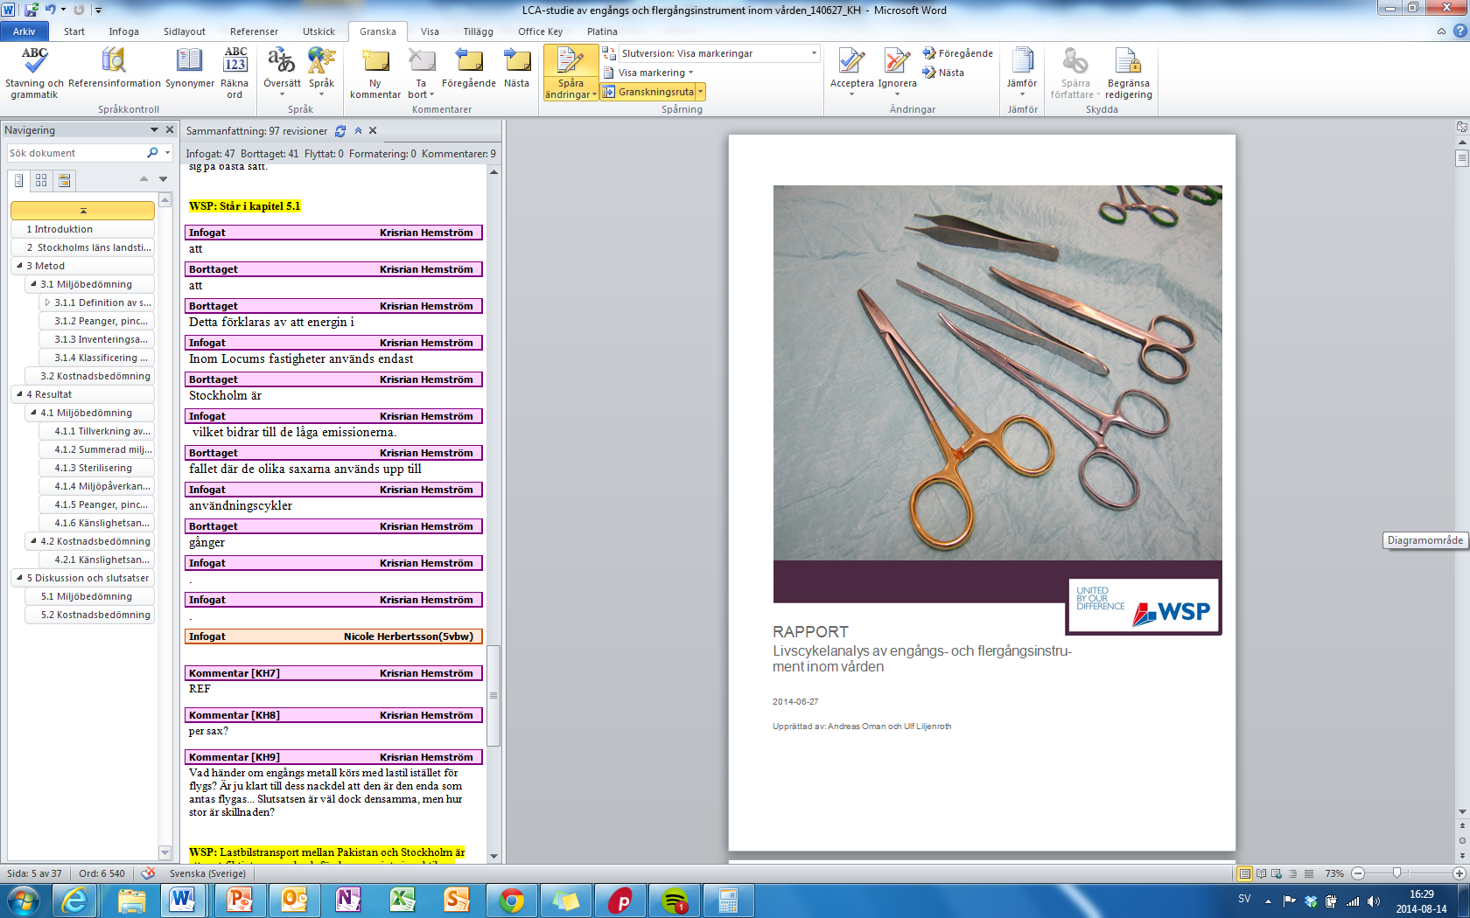
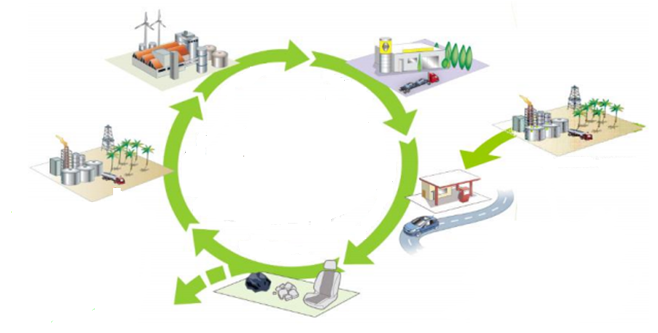
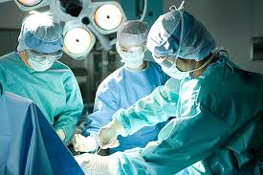
Hållbar konsumtion
Life cycle assessment of single and multi-use sissors at 1000 use cycles
Production
TRANSPORT/
DISTRIBUTION
REUSE
ENERGY PRODUCTION
RAW MATERIAL
EXTRACTION
RECYCLING
USE
INCINERATION
WASTE

Slide 8
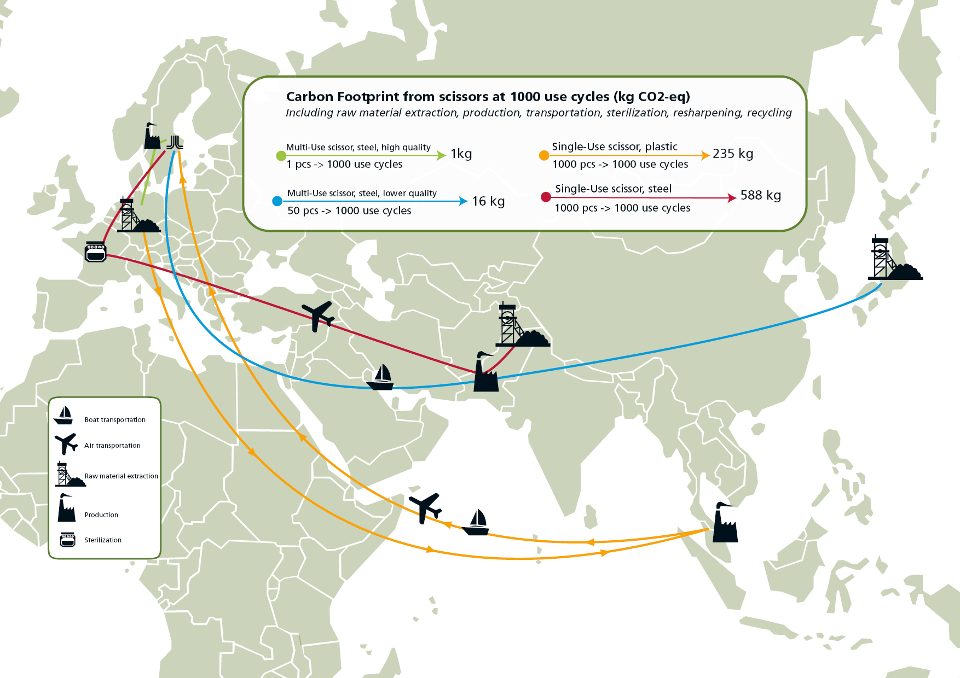
Multi-Use steel, high quality
Single-Use steel
Multi-Use steel, lower quality
Single-Use plastic

Slide 9
Modelling of Multi-Use scissors
Modelling of Single-Use scissors

Slide 11
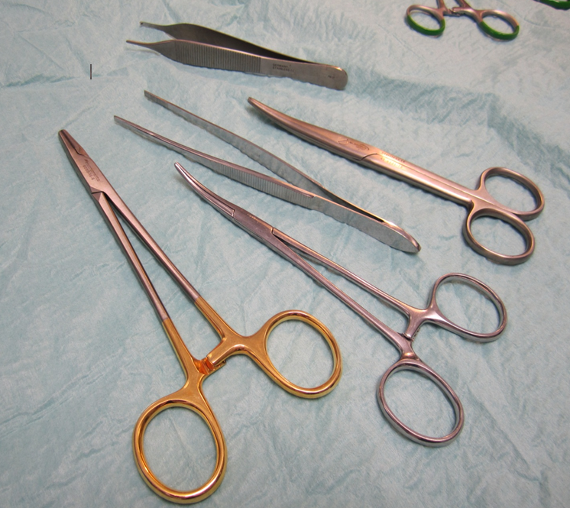

Slide 12
Multi-Use steel, high quality, 1 kg
Raw materials extraction
Sterilization
Resharpening
Single-Use steel, 588 kg
Raw materials extraction
Production
Transportation
Steel recycling compensate <10 % of carbon footprint of the single-use instrument

Slide 13
Costs at 1000 use cycles (approx…)
 | Scissor A | Scissor B | Scissor C | Scissor D
1000 use cycles | Multi-Use, lower quality | Multi-Use, high quality | Single-Use, steel | Single-Use, plastic
Quantity | 50 pcs | 1 pcs | 1 000 pcs | 1 000 pcs
Purchase (SEK) | 500 | 1400 | 10 000 | 15 000
Dishwashing (SEK) | 11 | 11 | 108 | 0
Sterilization (SEK) | 64 630 | 79 370 | 0 | 0
Resharpening (SEK) | 0 | 3080 | 0 | 0
Waste management (SEK) | -1,1 | -0,02 | -23 | 12
TOTAL COSTS (SEK) | 65 140 | 80 781 | 10 085 | 15 012

Slide 14
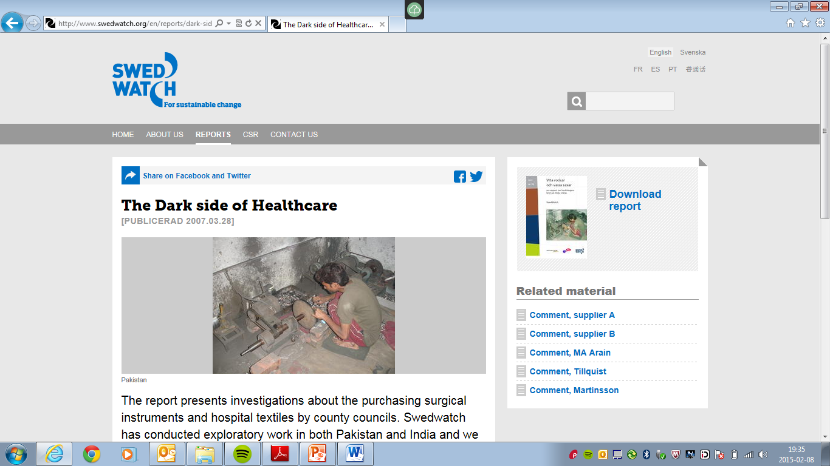
Does the price come with a cost?
Child labour
Hazardous working conditions
Wages below minimum wage
Etc.

Slide 15

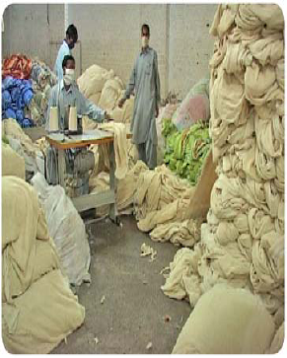
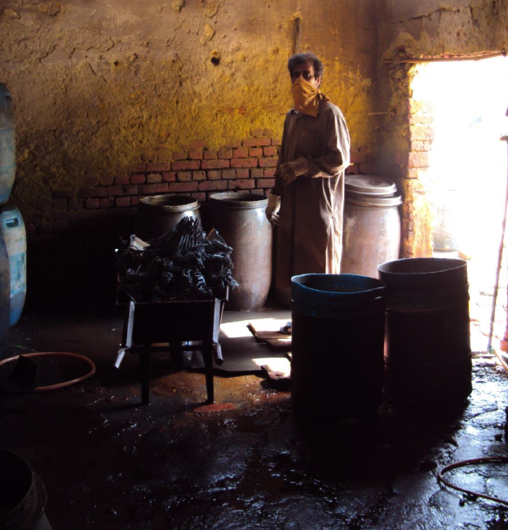
Code of Conduct
Notes:
15

Slide 16
Code of Conduct
Co-operation between all Swedish Regions and County Councils
UN Declaration of Human Rights
ILO eight core conventions for workers rights
All work-related health and safety legislation in the manufacturing country
Decent wages and working hours
Environmental demands
Anti-corruption

Slide 17
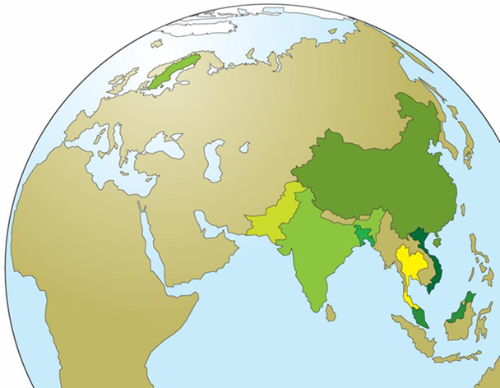
Seven prioritized risk-areas
Instruments and stainless steel medical products – Pakistan
Disposable operation products – Thailand, Malaysia
Gloves – Malaysia, Vietnam, China
Dressings – China
Textiles – India, Bangladesh, Pakistan
IT - China
Pharmaceuticals – India, China

Slide 18
Follow-ups
Self-Assesment
2009: Textiles, Instruments, Gloved
2010: Gloves, Surgical articles, Dressings, Laparaskopi
2012: Surgical textiles, IT
2013: Pharmaceuticals, Instruments
Audits:
2009: Instruments, Textiles
2010: Gloves
2013: IT, Textiles, Pharmaceuticals, Instruments
2015: IT, Textiles, Pharmaceuticals, Instruments, Gloves

Slide 19

Follow-up surgical instruments Pakistan 2014
Wages at minimum wage
Overtime regulated
Child labour countered
Improved working conditions
Personal protection equipement
Stagnating prices/increased costs
http://www.swedwatch.org/sv/video/healthier-procurement

Slide 20
Conclusions (at 1000 use cycles)
Single-use steel instruments emits almost 600 times more greenhouse gases, and consumes 17 times more energy, than high quality reusable instrument
Reusable instruments come with approximately 8 times the cost, mainly due to high sterilisation costs
Carbon footprint from sterilization of high quality reusable instrument <1 % of total carbon footprint from single-use steel instruments
Recycling compensate <10 % of carbon footprint

Slide 21
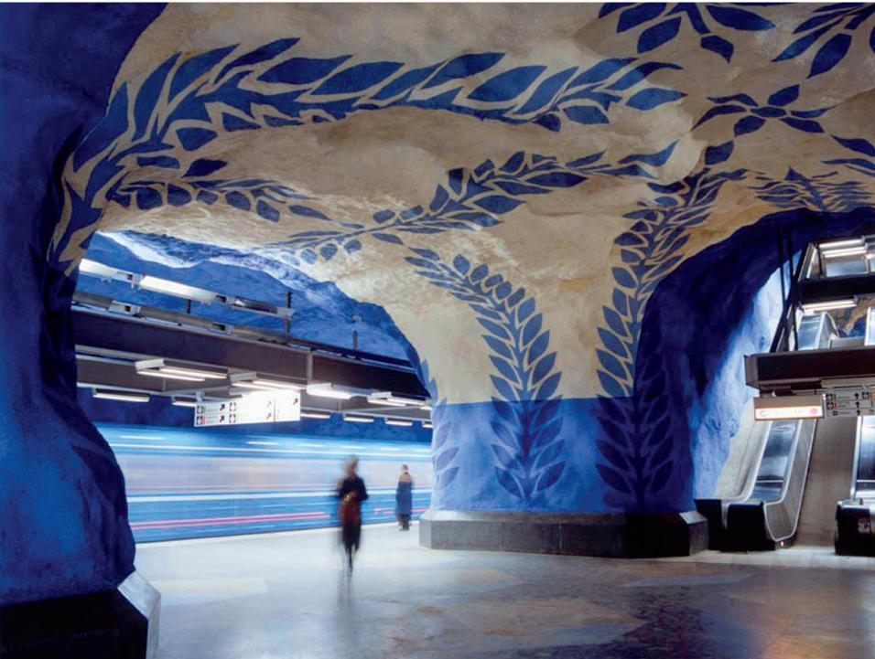
Thanks for your attention
Kristian Hemström
Kristian.Hemstrom@sll.se
+46 8 123 144 66

